Slide 1
Capital budgeting technique

Slide 2
Techniques of Capital Budgeting
Capital budgeting is mathematical in nature which means that there are certain techniques related to quantitative investment and are employed to determine the worth of an opportunity of investment. Following are the important techniques of capital budgeting.
Pay Back Period
Return on Investment
Net Present Value (NPV)
Profitability Index (PI)
Internal Rate of Return (IRR)
Accounting rate of return

Slide 3
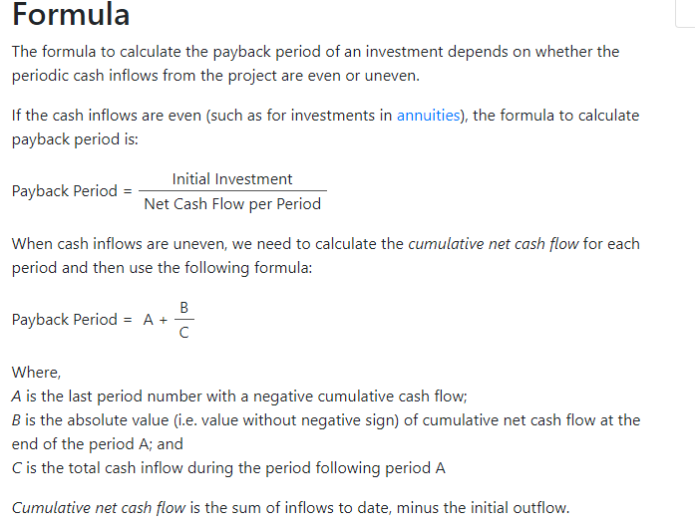

Slide 4
Example 1: Even Cash Flows
Q. Company C is planning to undertake a project requiring initial investment of $105 million. The project is expected to generate $25 million per year in net cash flows for 7 years. Calculate the payback period of the project.
Solution
Payback Period = Initial Investment ÷ Annual Cash Flow = $105M ÷ $25M = 4.2 years

Slide 5
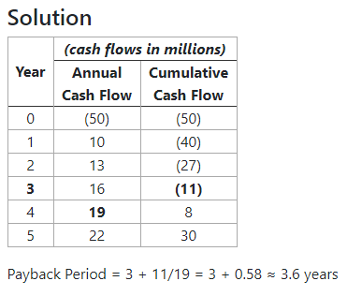
Example 2: Uneven Cash Flows Q.2Company C is planning to undertake another project requiring initial investment of $50 million and is expected to generate $10 million net cash flow in Year 1, $13 million in Year 2, $16 million in year 3, $19 million in Year 4 and $22 million in Year 5. Calculate the payback value of the project.
Payback Period = 3 + 11/19 = 3 + 0.58 ≈ 3.6 years

Slide 6
Net present value method
Net present value (NPV) of a project represents the change in a company's net worth/equity that would result from acceptance of the project over its life. It equals the present value of the project net cash inflows minus the initial investment outlay. It is one of the most reliable techniques used in capital budgeting because it is based on the discounted cash flow approach.
Net present value calculations require the following three inputs:
Projected net after-tax cash flows in each period of the project.
Initial investment outlay
Appropriate discount rate i.e. the hurdle rate.
Net after-tax cash flows equals total cash inflow during a period, including salvage value if any, less cash outflows (including taxes) from the project during the period.
The initial investment outlay represents the total cash outflow that occurs at the inception (time 0) of the project.
The present value of net cash flows is determined at a discount rate which is reflective of the project risk. In most cases, it is appropriate to start with the weighted average cost of capital (WACC) of the company and adjust it up or down depending on the difference between the risk of the specific project and average risk of the company as a whole.

Slide 7
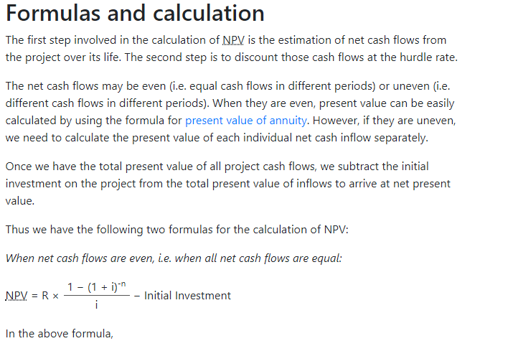

Slide 8
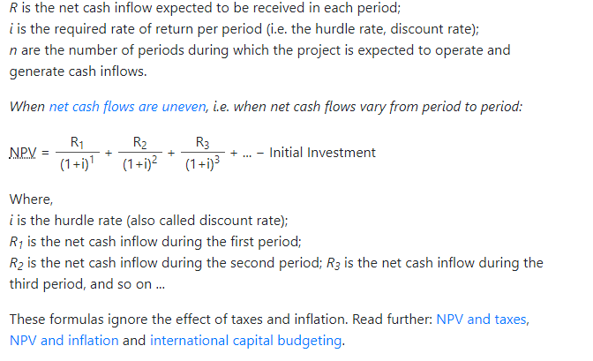

Slide 9
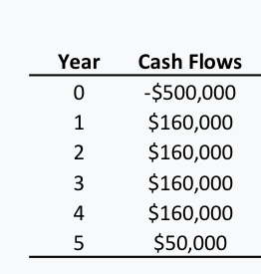
Q. Solve this numerical with net present value method with an Interest rate = 13%

Slide 10
N.p.v = PV0+ PV1 + PV2 + pV3 + pV4
PV0 = FV0/ 1+ i)0= fvo= -500000
PV1 = FV1/ (1 + i)1= 160000/(1+.13)=141592.9
PV2= FV2/ (1 + i)2= 160000/( 1+.13)2=125303.4
Pv3 = fv3 / (1+.13)3= 16000/ 1.13^3= 110888.026
PV4=98131
PV5=27138
= 3052

Slide 11
Example: You invest $500 now, and get back $570 next year. Use an Interest Rate of 10% to work out the NPV
Ans n.p.v = - 500/ (1+.10)^0 + 570/ (1+ .10)^1
money Out: $500 now
You invest $500 now, so PV = −$500.00
Money In: $570 next year
PV = $570 / (1+0.10)¹ = $570 / 1.10
PV = $518.18 (to nearest cent)
And the Net Amount is:
Net Present Value = $518.18 − $500.00 = $18.18
So, at 10% interest, that investment has NPV = $18.18

Slide 12
Internal rate of return method
Example: Invest $2,000 now, receive 3 yearly payments of $100 each, plus $2,500 in the 3rd year.
find irr
n.p.v = 0
Lets try 10%
N.P.V = -2000+ 100/(1+.10)+ 100/(1+ .10)^2 + 100/(1+.10)^3 + 2500/ ( 1+.10)^4 = 127.5 approx

Slide 13
Lets try 12%
N.P.V = -2000+ 100/(1+.12)+ 100/(1+ .12)^2 + 100/(1+.12)^3 + 2500/ ( 1+.12)^4 = 26.42
Lets try 13%
N.P.V = -27
Therefore 12.5% N.P.V =0

Slide 14
XYZ Company is looking to invest in some new machinery to replace its current malfunctioning one. The new machine, which costs $420,000, would increase annual revenue by $200,000 and annual expenses by $50,000. The machine is estimated to have a useful life of 12 years and zero salvage value.

Slide 15
Step 1: Calculate Average Annual Profit
Inflows, Years 1-12(200,000*12)$2,400,000
Less: Annual Expenses(50,000*12)-$600,000
Less: Depreciation-$420,000
Total Profit$1,380,000
Average Annual Profit(1,380,000/12)$115,000
Step 2: Calculate Average Investment
Average Investment($420,000 + $0)/2 = $210,000 Step 3: Use ARR Formula
ARR = $115,000/$210,000 = 54.76%

Slide 16
SHREE CEMENT LTD is looking to invest in some new machinery to replace its current malfunctioning one. The new machine, which costs $1000,000, would increase annual revenue by $500,000 and annual expenses by $20,0000. The machine is estimated to have a useful life of 10 years and zero salvage value.

Slide 17
Total revenue = (500000*10) =5000000
total expenses = (200000*10) = 2000000
profit = 5000000-2000000= 3000000
Net profit = 3000000-1000000 = 2000000
Avg investment = ( 1000000/2) = 500000
Net profit anually = 2000000/10 = 200000
ARR = 200000/500000 = .4 = 40%

Slide 18
MARUTI SUZUKI is considering investing in a project that requires an initial investment of $500,00 for some machinery. There will be net inflows of $50,00 for the first two years, $20,000 in years three and four, and $10,000 in year five. Finally, the machine has a salvage value of $35,000.

Slide 19
Net Inflows
5000*2 = 10000Rs
20000* 2 = 40000Rs
10000*1 = 10000Rs
Total = 60000RS
NET profit = (60000-(50000-35000)=45000
Annual net profit = 45000/5 = 9000
Average investment = 50000+35000/2= 42500
ARR= 9000/42500 = .211 = 21.1%

